Slide 1

EMPLOYEE DATA ANALYSIS
BY MRINAL DESHMUKH

Slide 2


INTRODUCTION
Data File
Employee_data
Employee_engagement_survey_data
Recruitment_data
Training_and_development_data
Task Assign
Convert the data into insightful output and dashboard design

Slide 3
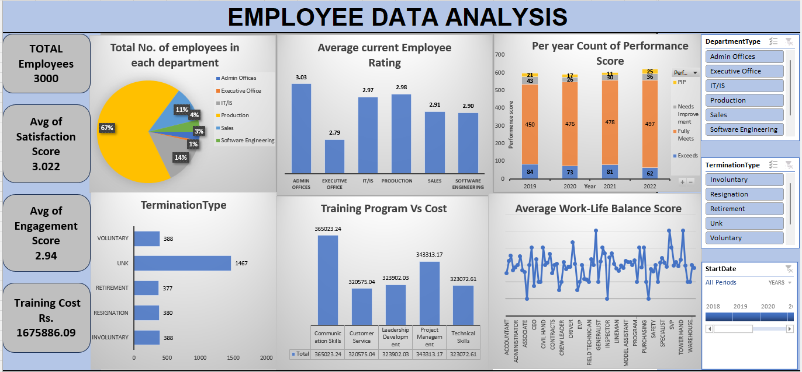

Slide 4
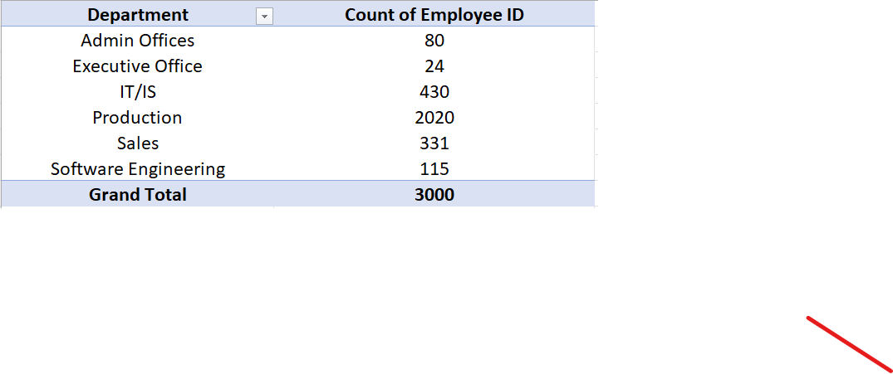
Can you create a pivot table to summarize the total number of employees in each department?

Slide 5
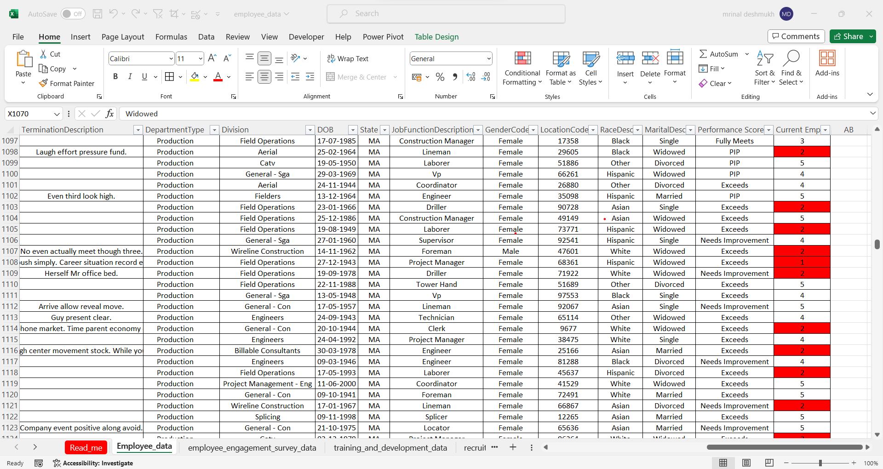
Apply conditional formatting to highlight employees with a "Performance Score" below 3 in red.

Slide 6
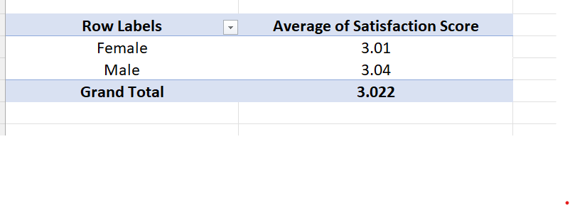
Calculate the average "Satisfaction Score" for male and female employees separately using a pivot table

Slide 7
Create a chart to visualize the distribution of "Work-Life Balance Score" for different job functions.

Slide 8

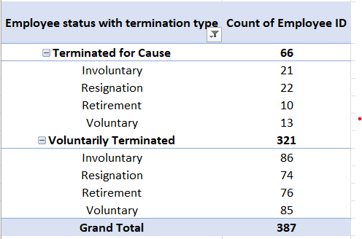
Filter the data to display only terminated employees and find out the most common "Termination Type."

Slide 9
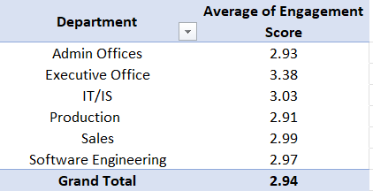
Calculate the average "Engagement Score" for each department using a pivot table.

Slide 10
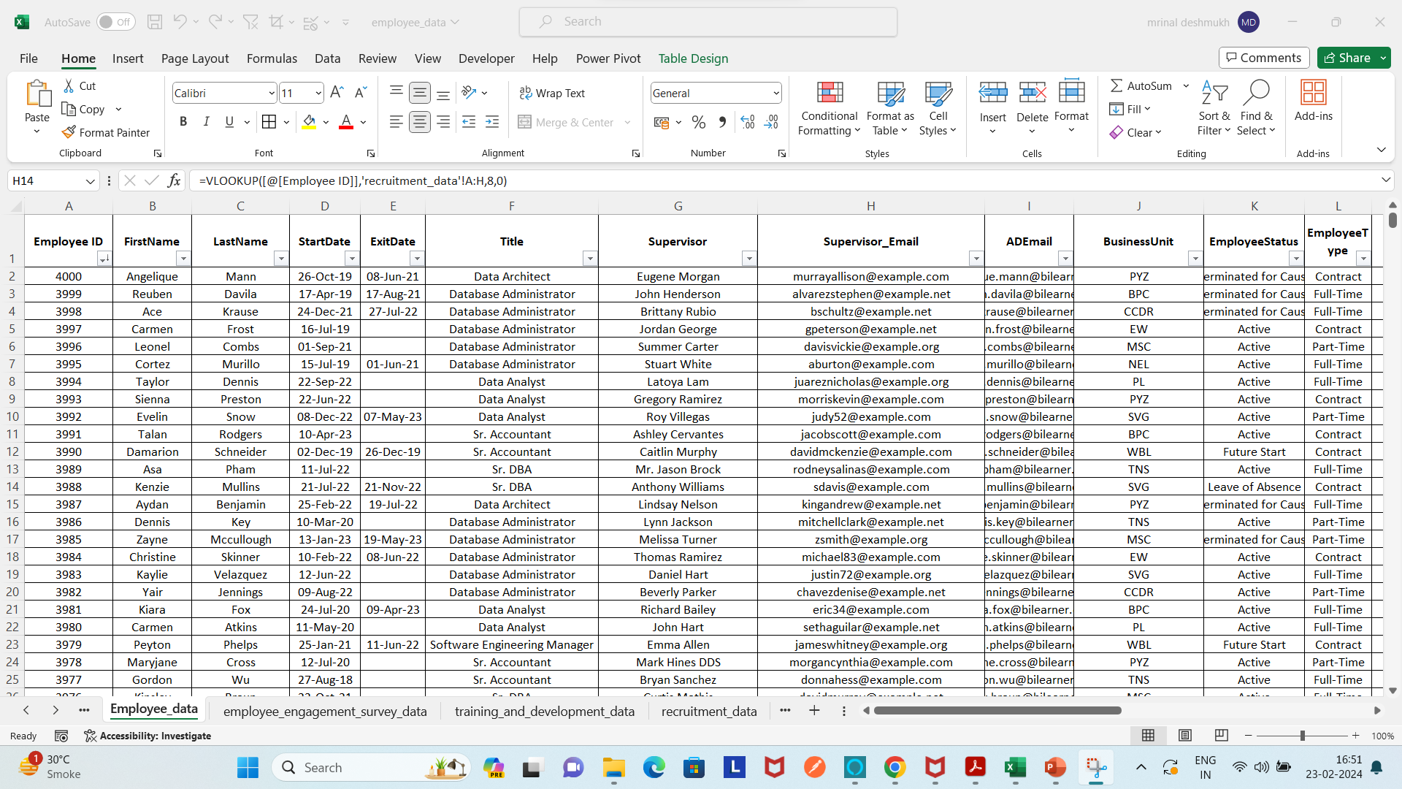
Use VLOOKUP to find the supervisor's email address for a specific employee
=VLOOKUP([@[Employee ID]],'recruitment_data’!$A:$H,8,0)

Slide 11
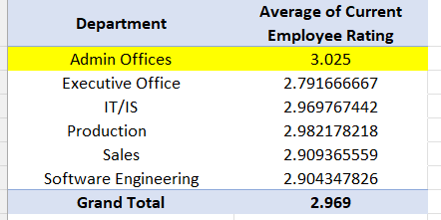
Can you identify the department with the highest average "Employee Rating?"

Slide 12
Create a scatter plot to explore the relationship between "Training Duration (Days)" and "Training Cost."

Slide 13
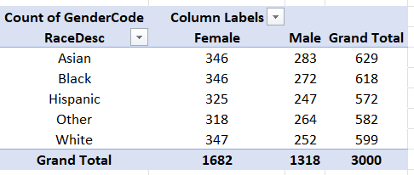
Build a pivot table that shows the count of employees by "RaceDesc" and "GenderCode."

Slide 14
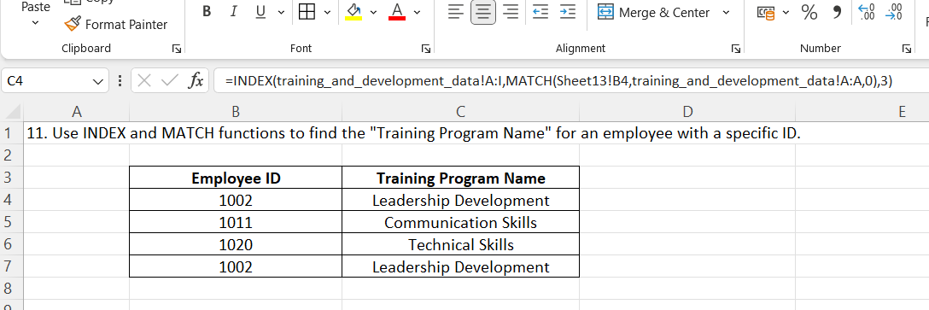
Use INDEX and MATCH functions to find the "Training Program Name" for an employee with a specific ID.
=INDEX(training_and_development_data!A:I,MATCH(Sheet13!B4,training_and_development_data!A:A,0),3)

Slide 15
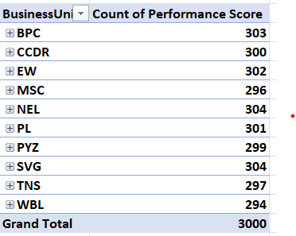
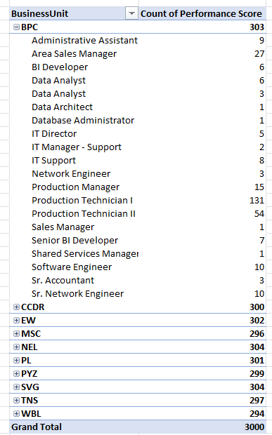
Create a multi-level pivot table to analyze the "Performance Score" by "BusinessUnit" and "JobFunctionDescription."

Slide 16
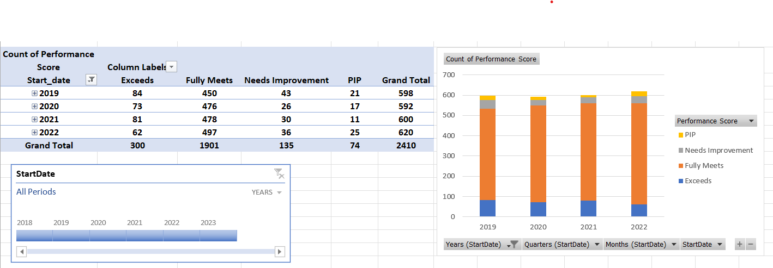
Design a dynamic chart that allows users to select and visualize the performance of any employee over time.

Slide 17
Calculate the total training cost for each "Training Program Name" and display it in a bar chart.

Slide 18
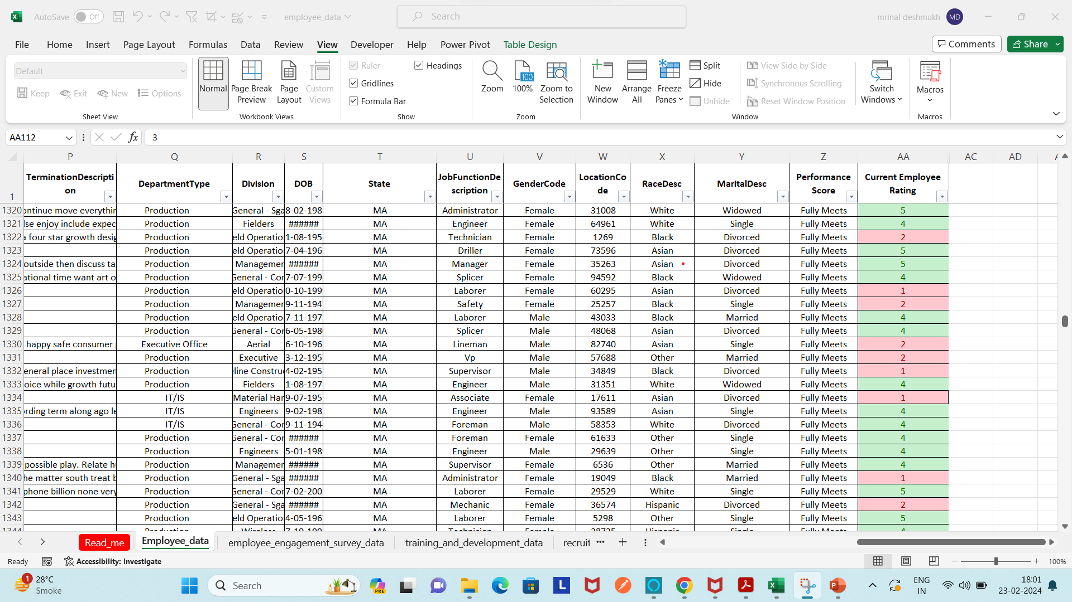
Apply advanced conditional formatting to highlight the top 10% and bottom 10% of employees based on "Current Employee Rating."

Slide 19
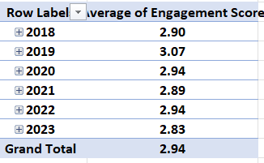
Use a calculated field in a pivot table to determine the average "Engagement Score" per year.

Slide 20
Create a histogram to understand the distribution of "ExitDate" for terminated employees.

Slide 21
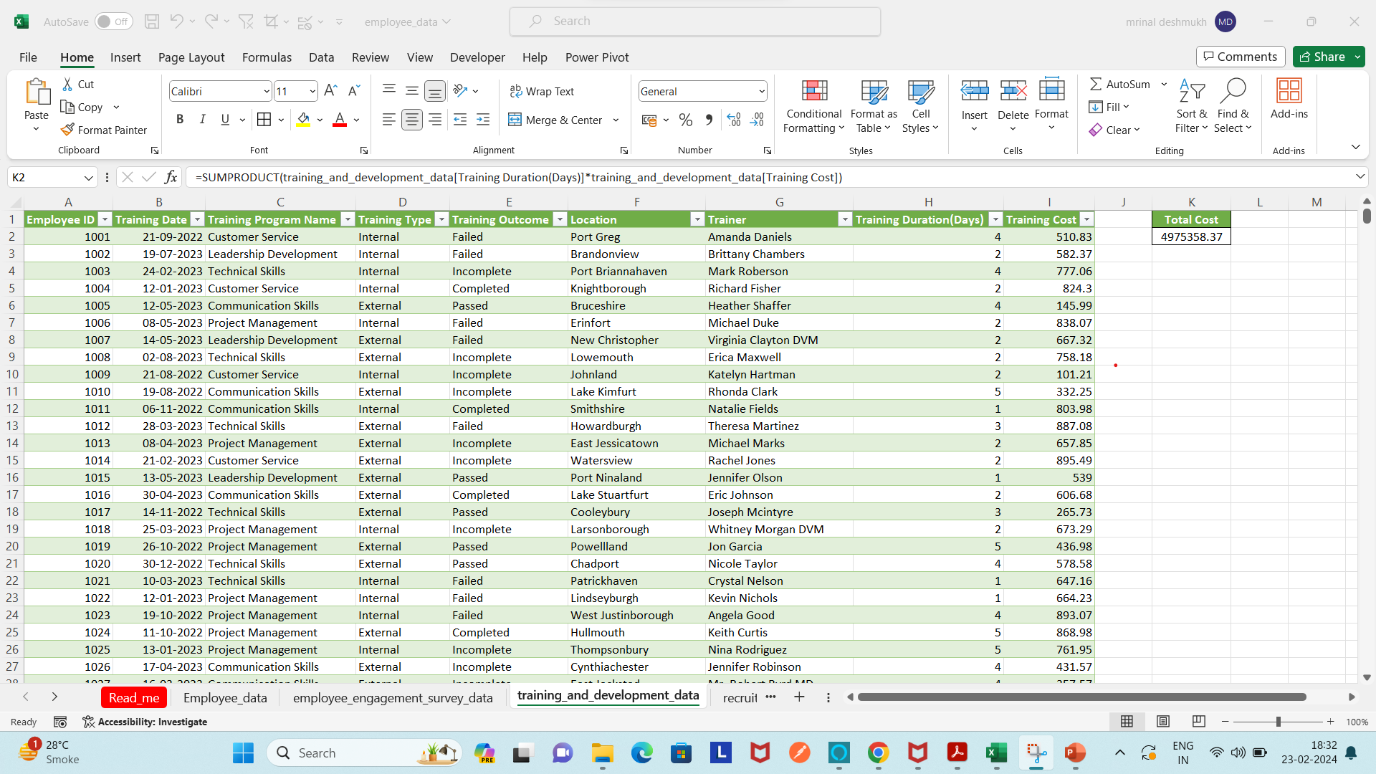
Utilize the SUMPRODUCT function to calculate the total training cost for employees in a specific location.

Slide 22
THANKING YOU !

